Slide 1

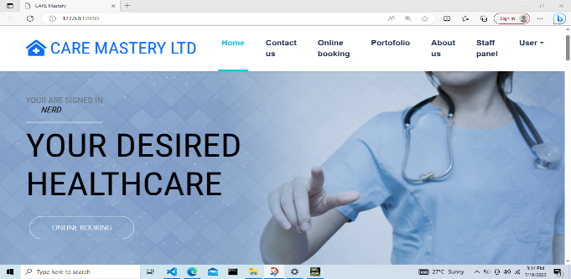
Clinic Booking
Introducing
A comprehensive web applications using the Django framework and CSS.
B
by Bright Mpala

Slide 2


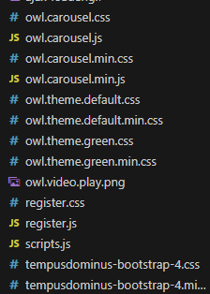
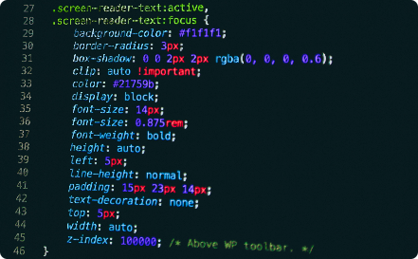

Simple ways building the websites
Step 1: Setup
Step 2: Models & Migrations
Install Django and create a new project using the command line.
Designed database schema using Django's models and apply the changes with migrations.
Step 3: Views & Templates
Step 4: Testing
Define views to handle user requests and create dynamic templates to render the data.
Write tests to ensure your app functions correctly and meets requirements.

Slide 3

Common features of the website
Booking in 🖥️
User Authentication 🔒
Add secure user authentication and permission management to your application.
The user can book in easily without any hesitation
Forms & Validation 📝
RESTful APIs 🌐
There arecreated and processed web forms with built-in validation and error handling.
Build APIs that allow your app to communicate with other systems and services.

Slide 4


Coding
I used css, bootstrap and java to create special effect and to beatify the website.
I added few css libraries..
I also used bootstrap for beautifying the website to make it user friendly.

Slide 5

Why I Used Django?
1
Robust Framework 💪
2
Efficient Development 🚀
3
Active Community 👥
Django provides a solid foundation to quickly develop secure and scalable web applications.
With Django's built-in features, such as object-relational mapping and form handling, developers can focus on writing high-level code.
Django has a large and supportive community that provides constant updates, solutions, and resources.

Slide 6

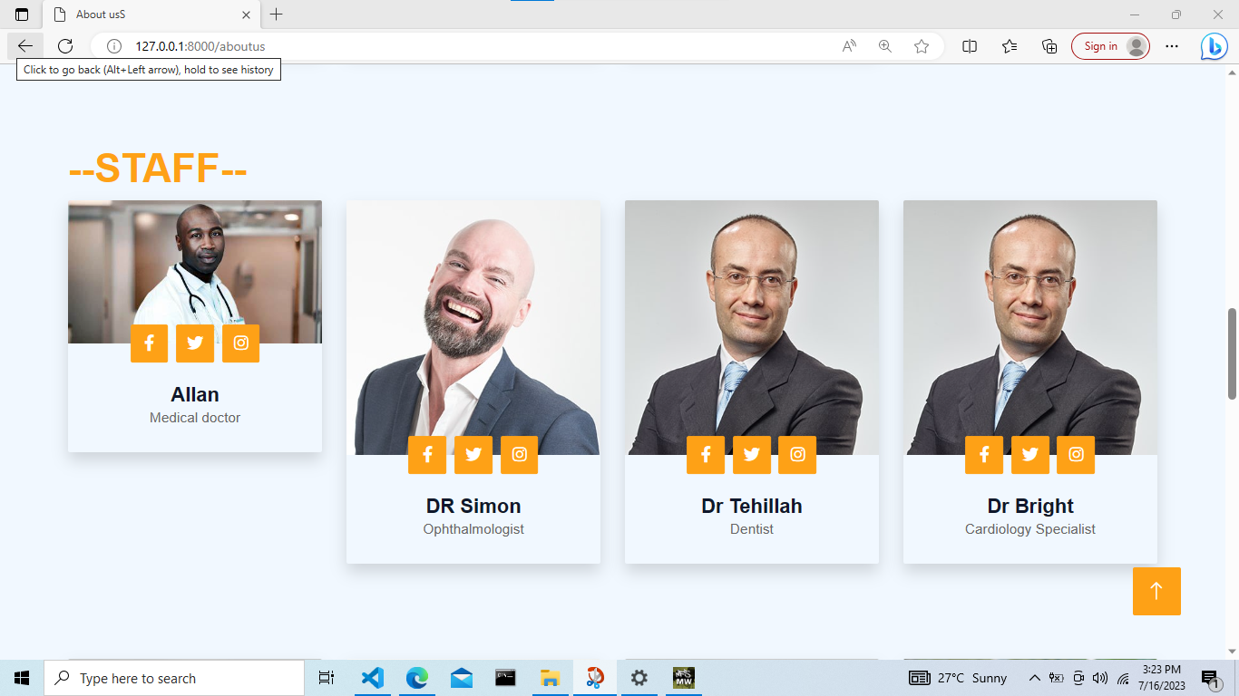
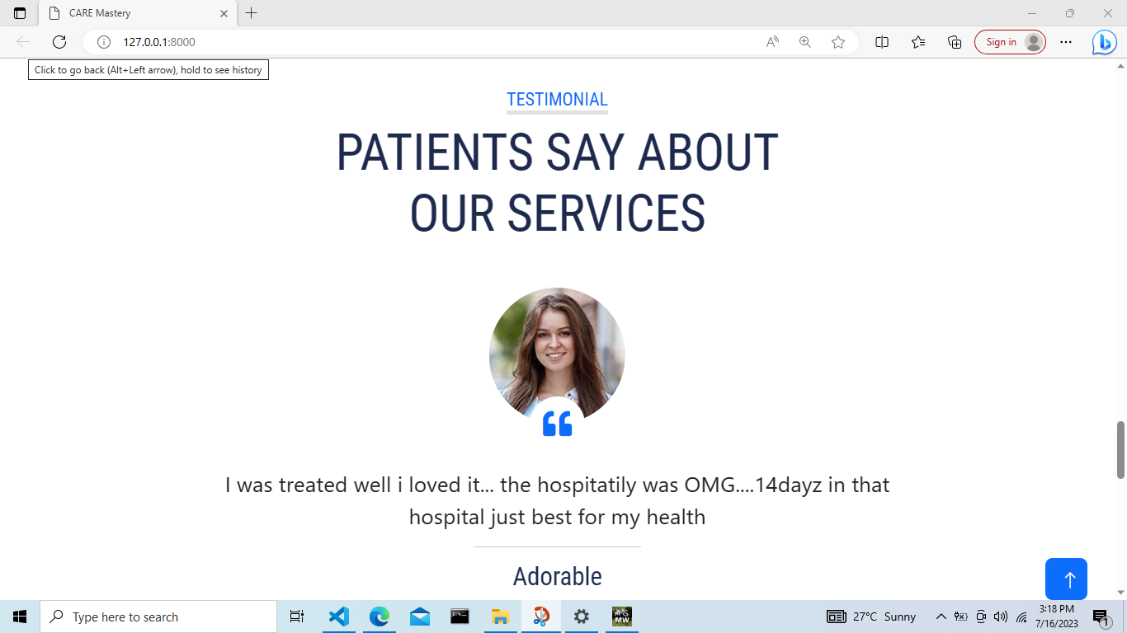
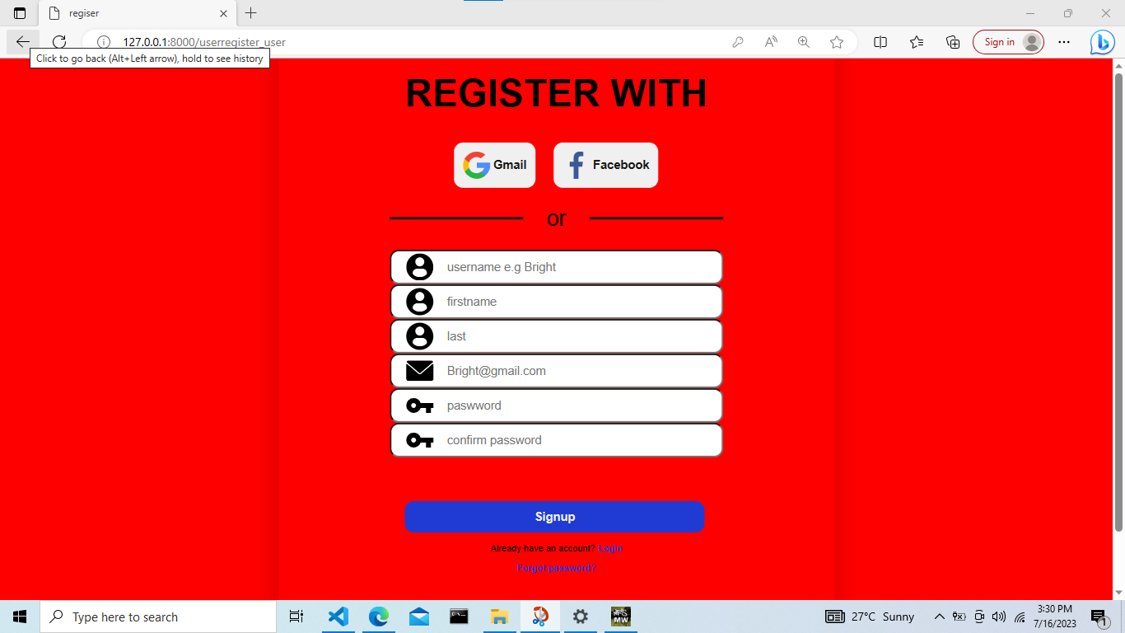
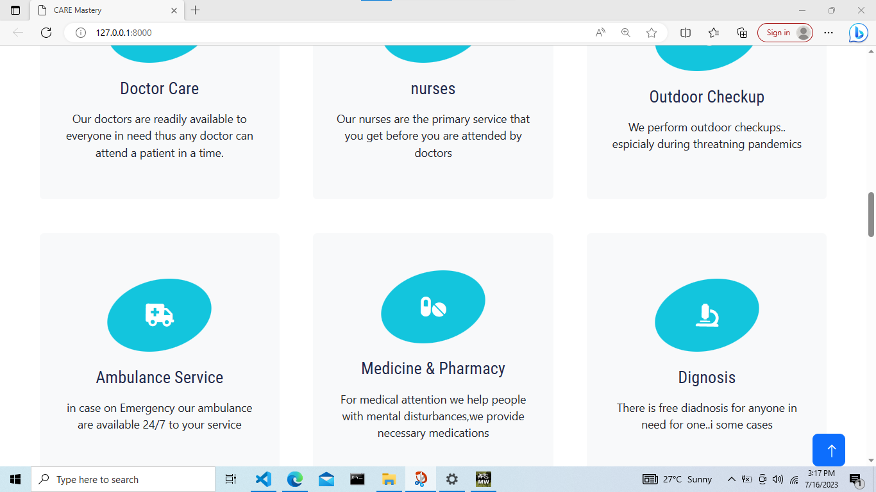
Why I used CSS
1
Custom Styling 🎨
Use CSS to transform my web app with beautiful designs and layouts.
2
Responsive Web Design 📱
Create mobile-friendly applications that adapt to various screen sizes and devices.
3
Animations & Transitions ✨
Add visual enhancements to your web app using CSS animations and transitions.
4
Browser Compatibility 🌐
CSS ensures the consistent appearance and behavior of your app across different web browsers.

